Slide 1
Release Time, Deadline & Timing Constraints

Slide 2
Job – Each unit of work that is scheduled and executed by the system.
Task - A set of related jobs which jointly provide some system function a task.
Parameters that distinguish jobs in real-time systems from those in nonreal-time systems
1) Release Time
2) Deadline

Slide 3
Release Time & Response Time
Release time –
-The instant in time when a job becomes available for execution.
- A job can be scheduled and executed at any time or after, its release time, provided its resource dependency conditions are met.
Response time –
- The length of time from the release time of the job to the time instant when it completes.

Slide 4
Deadline
Deadline of a job is the instant of time by which its execution is required to be completed.
Control-law computation job must complete by the release time of the subsequent job.
A job has no deadline if its deadline is at infinity.

Slide 5
Completion time – the instant at which a job completes execution.
Relative deadline – the maximum allowable job response time.
Absolute deadline – the instant of time by which a job is required to be completed (often called simply the deadline)
absolute deadline = release time + relative deadline
Feasible interval for a job Ji is the interval ( ri, di ]
Deadlines are examples of timing constraints.

Slide 6
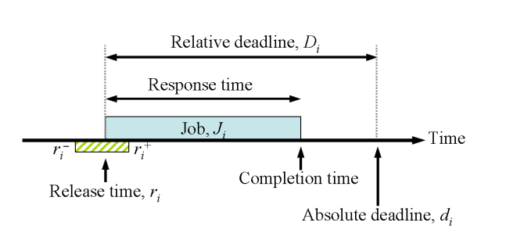

Slide 7
Timing Constraints
Timing constraint of a job can be specified in terms of its release time and relative or absolute deadlines.

Slide 8
Ex 1-
A system to monitor and control a heating furnace.
The system takes 20ms to initialize when turned on
After initialization, every 100 ms, the system: –
- Samples and reads the temperature sensor.
- Computes the control-law for the furnace to process temperature readings, determine the correct flow rates of fuel, air and coolant.
- Adjusts flow rates to match computed values

Slide 9
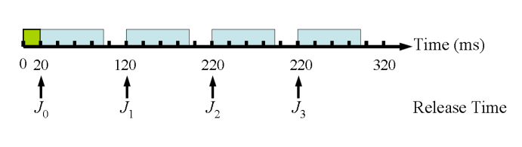
The periodic computations can be stated in terms of release times of the jobs computing the control-law: J0, J1, …, Jk, …
The release time of Jk is
20 + (k × 100) ms

Slide 10
Ex 2-.
Suppose each job must complete before the release of the next job:
-Jk’s relative deadline is 100 ms
-Jk’s absolute deadline is 20 + ((k + 1) × 100) ms
Alternatively, each control-law computation may be required to finish sooner – i.e. the relative deadline is smaller than the time between jobs, allowing some slack time for other jobs.

Slide 11
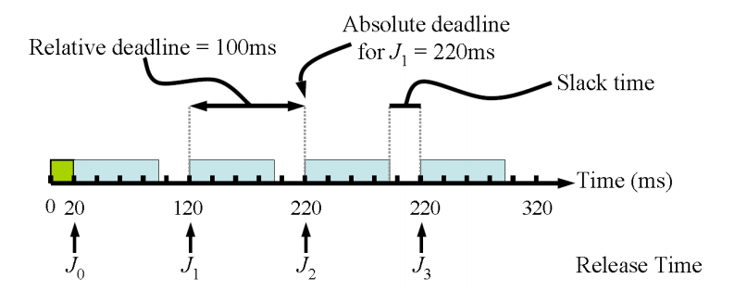
Slack time : the difference between the completion time and the earliest possible completion time

